Slide 1
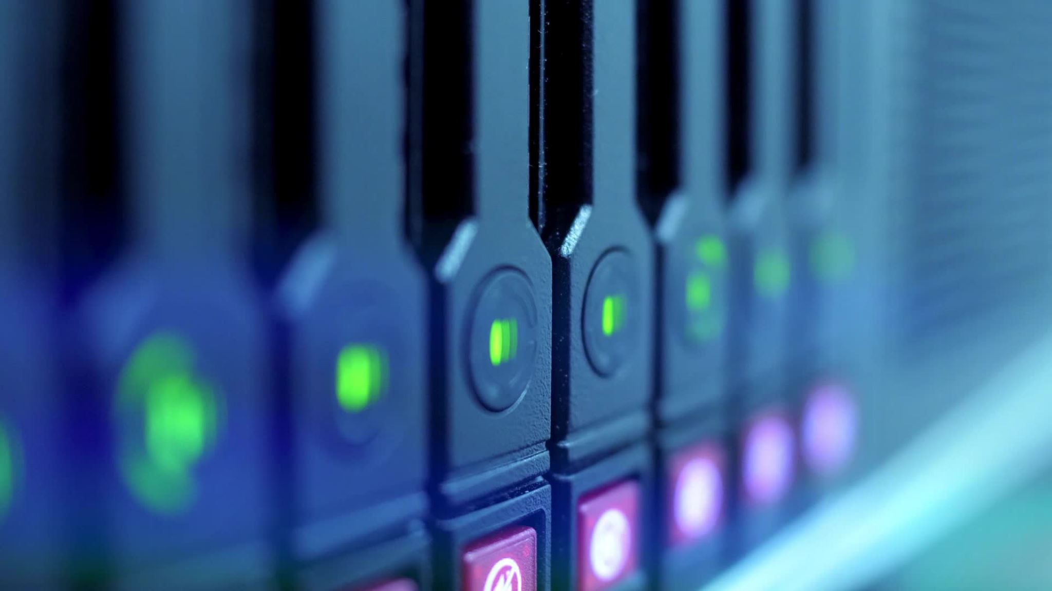
All About: Hardware and Computers
By: Madison Milliken.

Slide 2

What is Computer Hardware?
Computer hardware is any physical components of a computer. Hardware and software, which is a set of programs, work together to produce useful information to make the computer work successfully.
There are internal and external types of hardware
Internal External
CPU - Mouse
Network Interface Card -Keyboard
Optical Drives -Camera
www.techtarget.com/searchnetworking/definition/hardware.

Slide 3
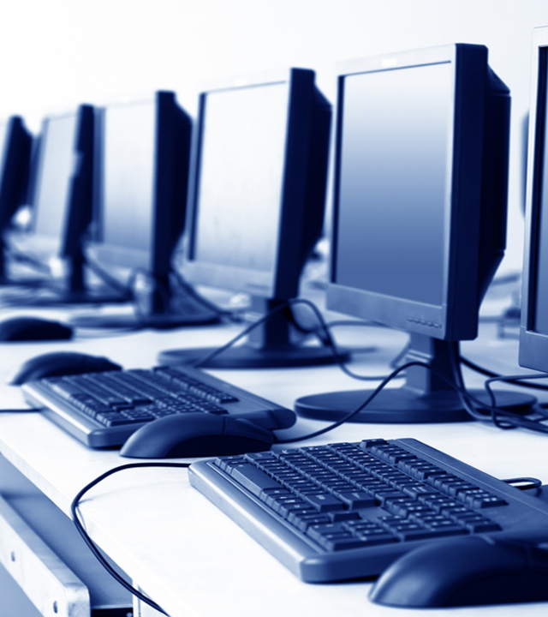
Types of Computers
Servers- A computer that provides services to other computers over the web. You don’t sit down at these types of computers. They only provide computer power over the internet. It has lots of memory and large hard drives.
Desktops-These computers provide large CRT monitors. Desktops are meant for use in a permanent spot. They give us more power and storage for cheaper costs.
Tablets- Portable computers that are smaller than normal computers. Tablets are compact and are used to access the internet. They come with a small amount of storage and are cheaper than any laptop you will find.
Handheld- Theses computers feature touch screens, highspeed processors, and many gigabytes of memory. The included camera, and connectivity options, including many more would surprise many electronic engineers from the past.
Wearable-All computer applications are added into a watch. Most wearables have all of the same qualities as an iPhone. The flexibility of always being able to have the device on your person has created a new wave of technological ideas.
computer.howstuffworks.com/10-types-of-computers.htm.

Slide 4

How Computers are Built
1.Planning and Budgeting- First understand what the use is for the computer you are building and then establish a budget so you don’t overpay for what you need to build it. When shopping for parts you will need to know which ones to buy. To build a computer you will need a processor, motherboard, RAM, storage drive, power supply, case, graphic cards, and a cooling system.
2.Buying Components- Buy the parts at a reliable store including best buy or shop online at Amazon. Before buying each component, research to make sure what you buy is working correctly. Find a CPU processor with a high processing speed so it can process data faster. Make sure to find the best parts you can for each piece of the computer.
3.Assembling The Parts- Use some type of tool to prevent electrostatic which can ruin your computers electronics. Open the case of the computer and install the power supply. Then you are going to add the components you need to the motherboard including your RAM and attaching your power supply to the power connectors. If needed apply thermal paste to the processor. Then attach the CPU cooler over the processor and screw it into the motherboard. Prepare the case of the computer then secure the motherboard by pushing it up against the backplate. Then plug the case connectors in and insert any storage drives into their slots. Connect your power supplies being your motherboard, graphic cards, and storage devices into any needed components. Make sure there are no complication and then close the case.
4.Powering On Your Computer- Attach your computer to an outlet. Plug in a monitor to your computer and turn it in. Install window or linux and install your drivers.
www.wikihow.com/Build-a-Computer.

Slide 5
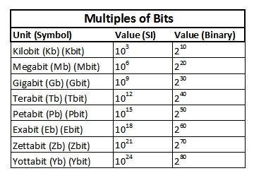
Multiples of Bits
Kilobit- A collection of about 1,000 bytes. This is used to measure data transfer speeds.
Megabit- A collection of 1,000,000 bytes. A data measurement unit applied to media or computer storage.
Gigabit- A collection of 1 billion bits. Used for measuring the amount of data that is transferred between telecommunication points.
Terabit- A collection of 1 trillion bytes. A unit of digital information storage used to distinguish the size of data.
Petabit-A collection of 1,000 terabytes. A unit used for measuring computer memory.
Exabit- A collection of 1,000 petabytes. Displays the content of a file or to start an application.
Zettabit- A collection of 1 billion terabytes. It’s a measure of digital storage capacity.
Yottabit- A collection of 1 million trillion megabytes. Use to denote the size of date.
www.techopedia.com/2/29184/development/programming-languages/understanding-bits-bytes-and-their-multiples

Slide 6
Refrences
Awati, Rahul . “What Is Computer Hardware? Everything You Need to Know.” SearchNetworking, Oct. 2021, www.techtarget.com/searchnetworking/definition/hardware.
Chandler, Nathan. “10 Types of Computers, from Wearables to Supercomputers.” HowStuffWorks, HowStuffWorks, 14 Nov. 2008, computer.howstuffworks.com/10-types-of-computers.htm.
Struyk, Tara. “Understanding Bits, Bytes and Their Multiples - Techopedia.” Understanding Bits, Bytes and Their Multiples, 2 June 2017, www.techopedia.com/2/29184/development/programming-languages/understanding-bits-bytes-and-their-multiples.
wikiHow. “Build a Computer.” WikiHow, wikiHow, 26 Nov. 2005, www.wikihow.com/Build-a-Computer.

